Slide 1

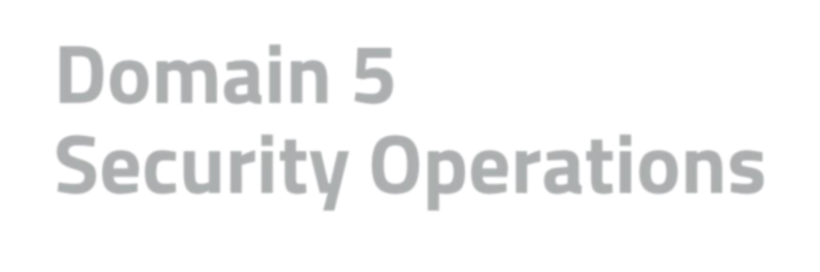
Domain 5 Agenda
Domain 5
Security Operations
Module 1: Understand Data Security
Module 2: Understand System Hardening
& Configuration Management
Module 3: Understand Best Practice Security Policies
Module 4: Understand Security Awareness
Training

Slide 2

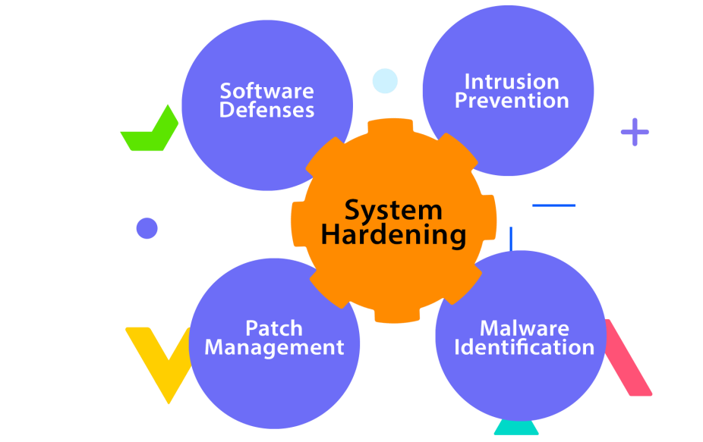

Hardening
Hardening is the process of applying secure configurations (to reduce the attack surface)
Remove unnecessary services
Update software and firmware
(Patching)
Enable firewalls
Use strong authentication with MFA
Conduct regular security assessments

Slide 3

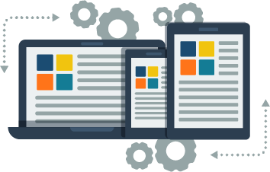

Configuration Management
Configuration Management (CM) is the process of identifying, organizing, testing, approving and managing the changes made to a system's components throughout their lifecycle.
This includes hardware, software,
documentation, and other related items.

Slide 4







Configuration Management Components
A validation process that involves testing
Defining the minimum level of protection that can be used as a reference point
and analysis, to verify that nothing was broken by a newly applied change
Change
Control
Verification
& Audit
Identification
Baseline
Defining and identifying the systems that need to be managed
An update process for requesting changes to a baseline, system or component

Slide 5
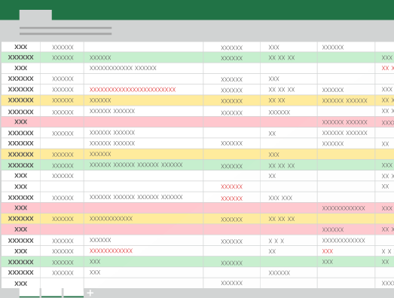
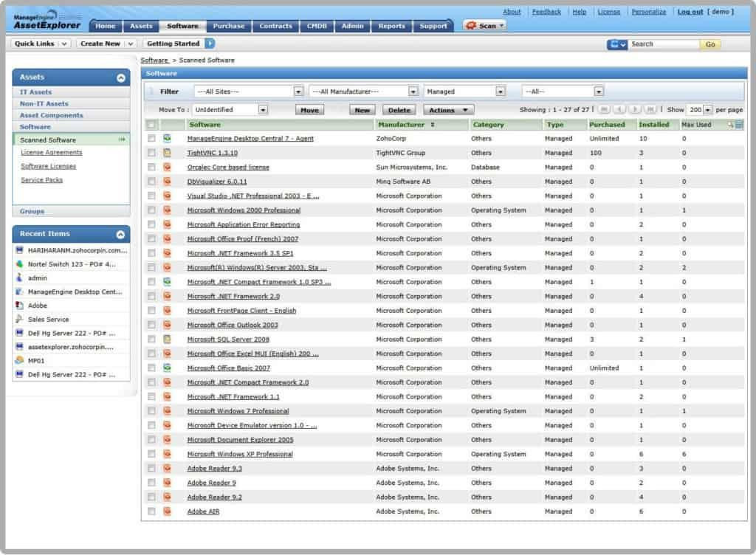

Inventory
A list of hardware, software, and other IT assets that an organization possesses. This includes all devices, such as computers, servers, mobile devices, routers, switches, and other networking equipment, as well as software applications, databases, and other digital assets.

